Slide 1
How to Find Public Domain Images Using Google Search
Mrs. Stanley
Sierra Middle School
2013-2014

Slide 2
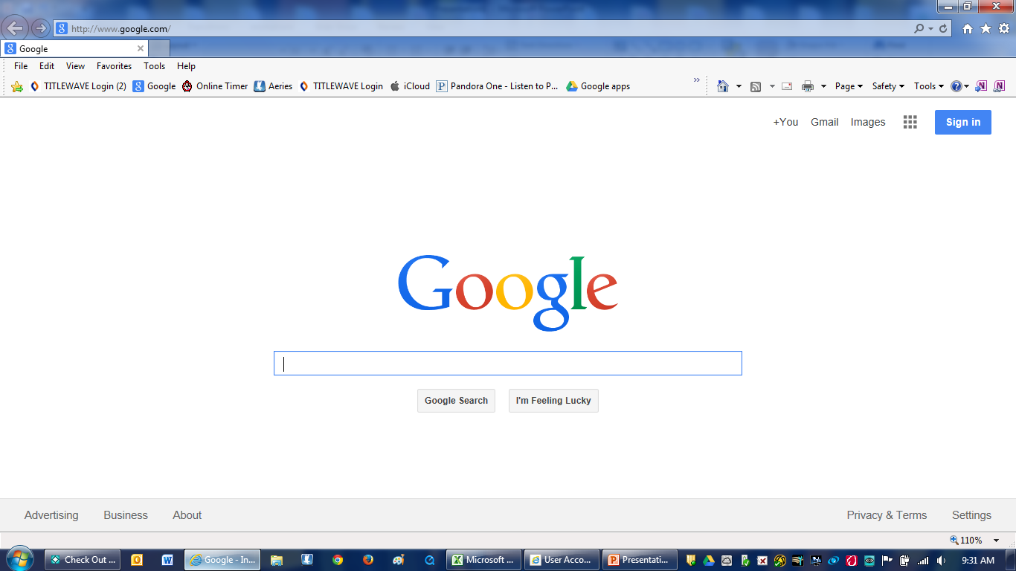
Open Google. Click on “Images.”

Slide 3
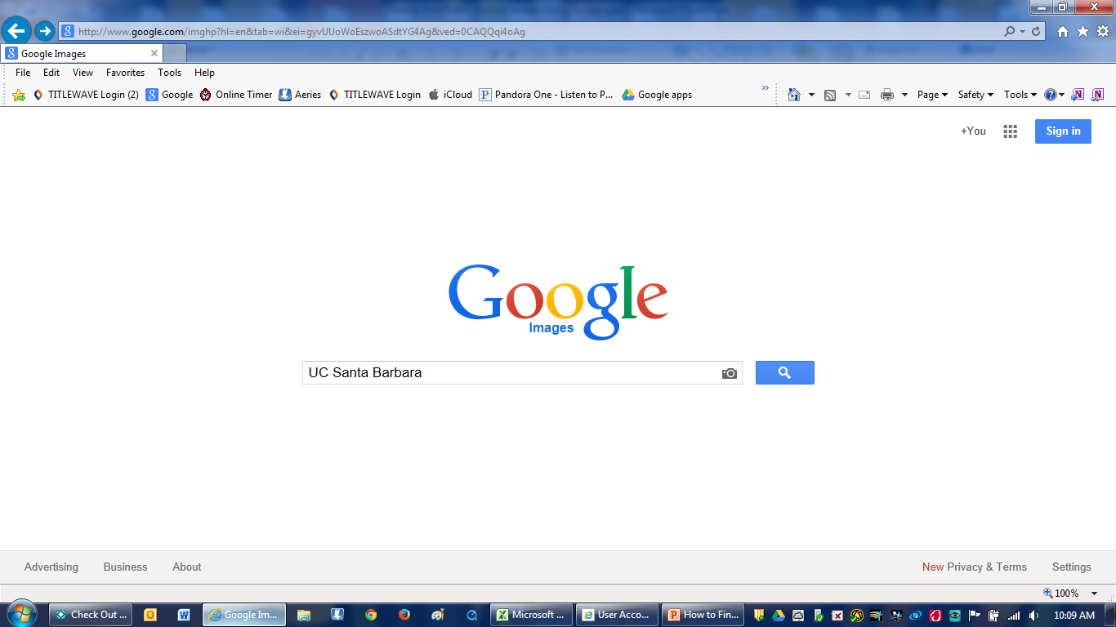
Type the name of the image.
Click the search icon

Slide 4
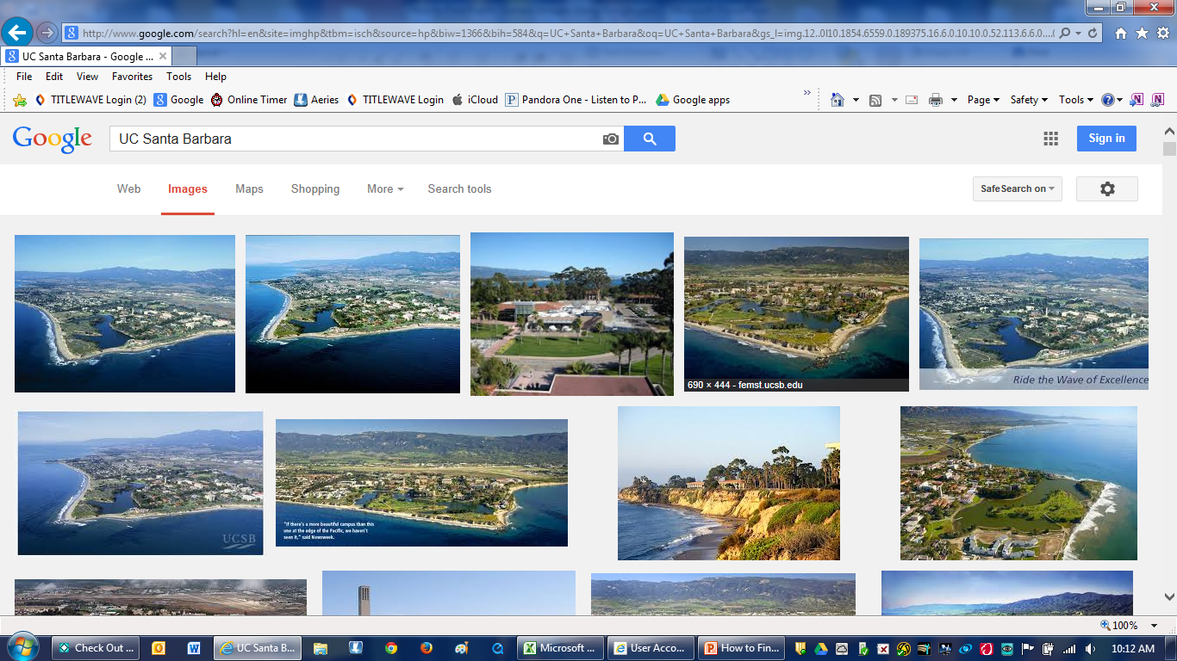
Click the gear icon.

Slide 5
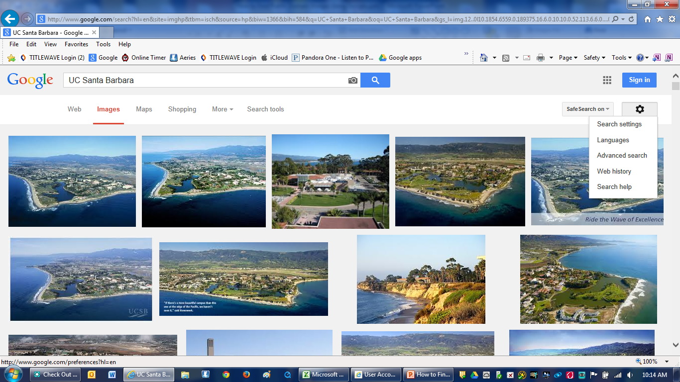
Click “Advanced search.”

Slide 6
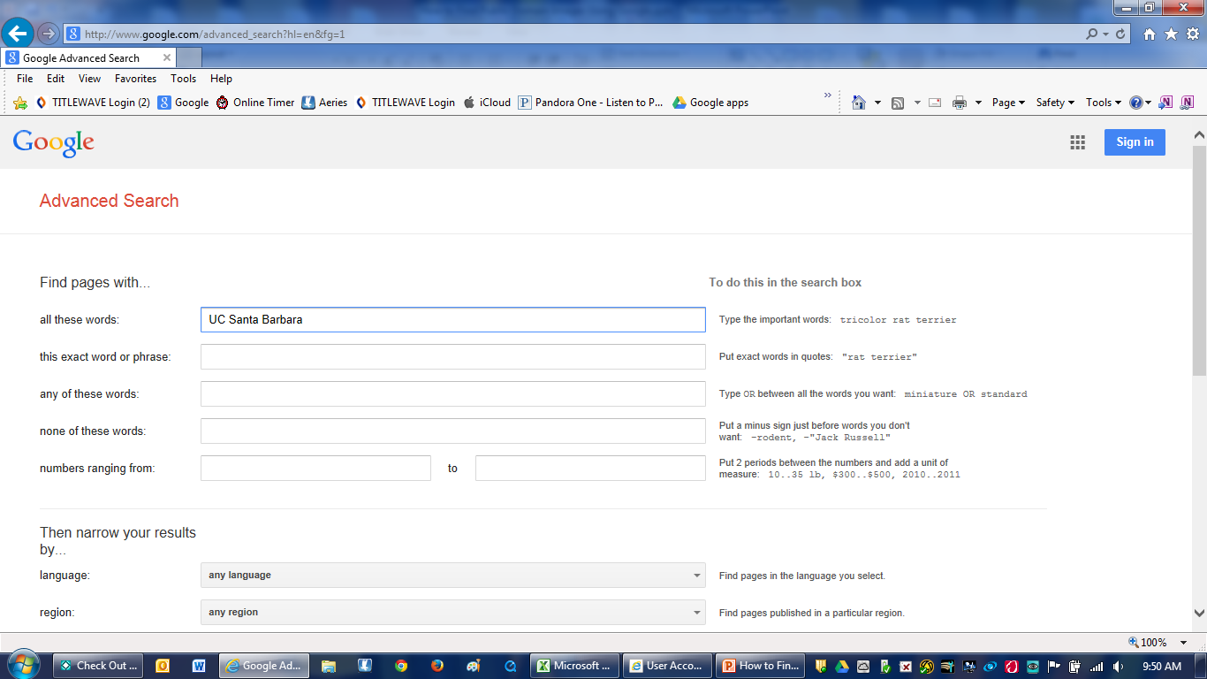
See or type the name of your image.

Slide 7
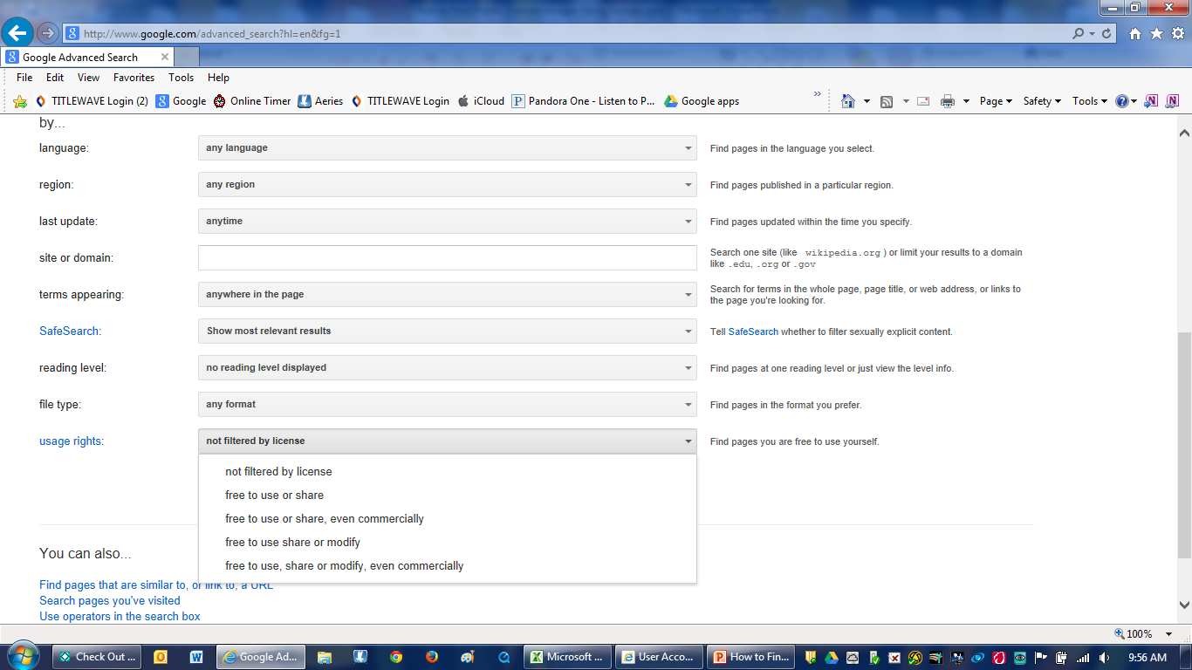
At bottom, beside “usage rights,” from drop-down arrow select “free to use or share.”

Slide 8
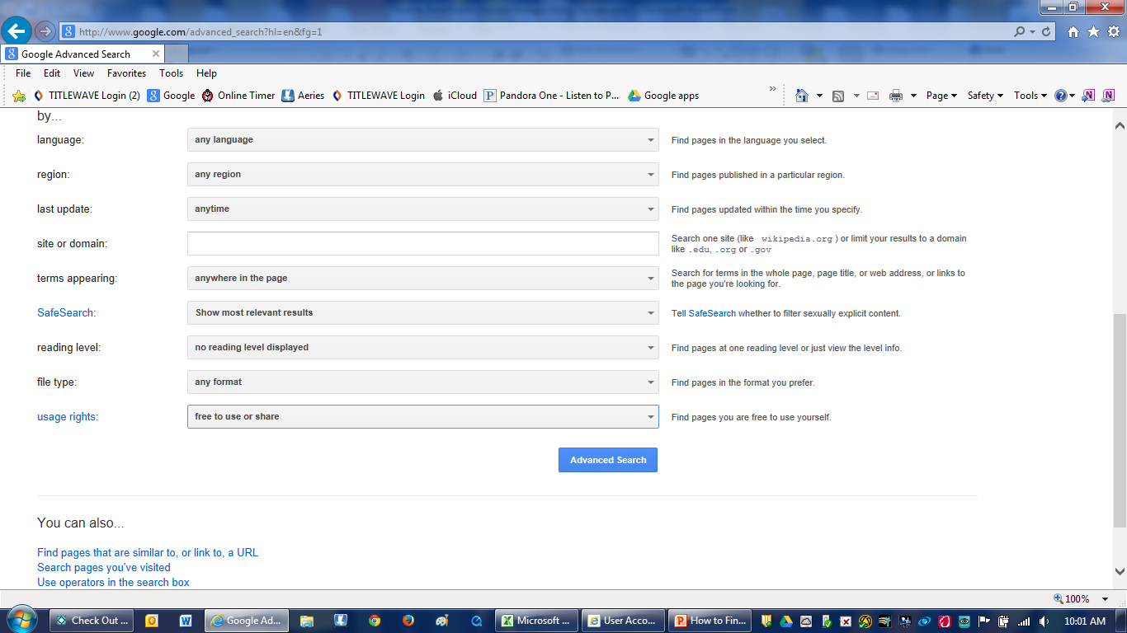
Click “Advanced Search.”

Slide 9
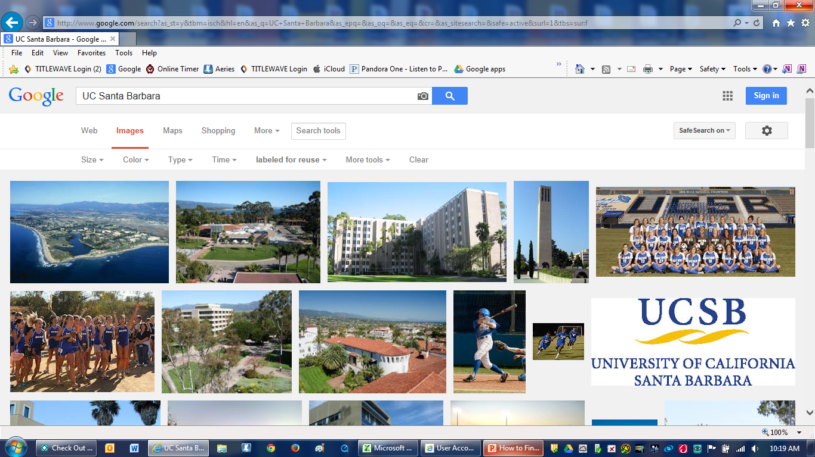
Click on desired image.

Slide 10
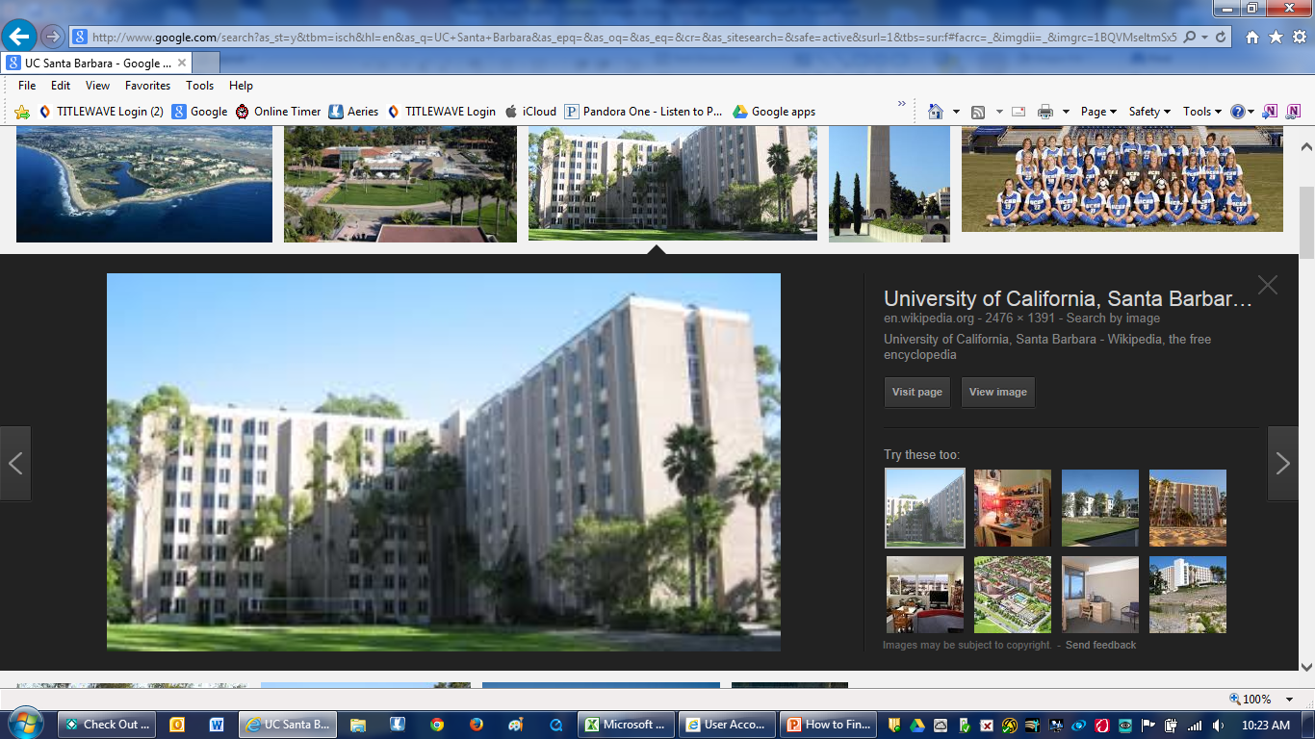

Slide 11
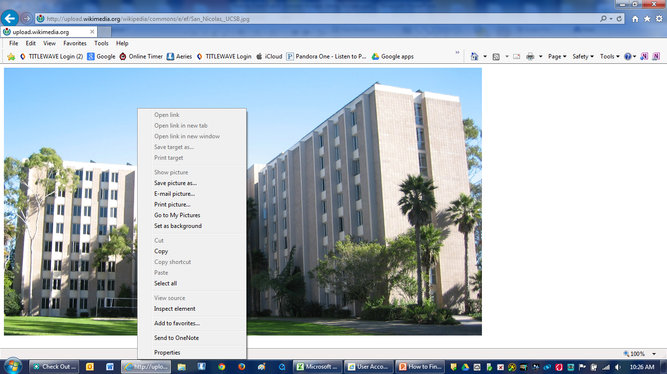
1.Touch image.
2.Right-click mouse.
3.Click “copy”

Slide 12
How to paste image into MS Word

Slide 13
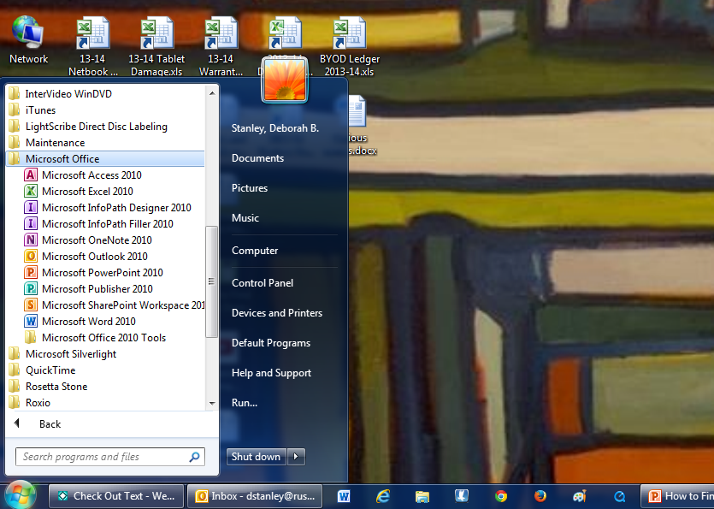
1. START
2. Click “All
Programs”
3. Click
“Microsoft
Office”
4. Click
“Microsoft
Word”

Slide 14
1. Select “Page Layout”
2. Click “Orientation”
3. Click “Landscape”

Slide 15
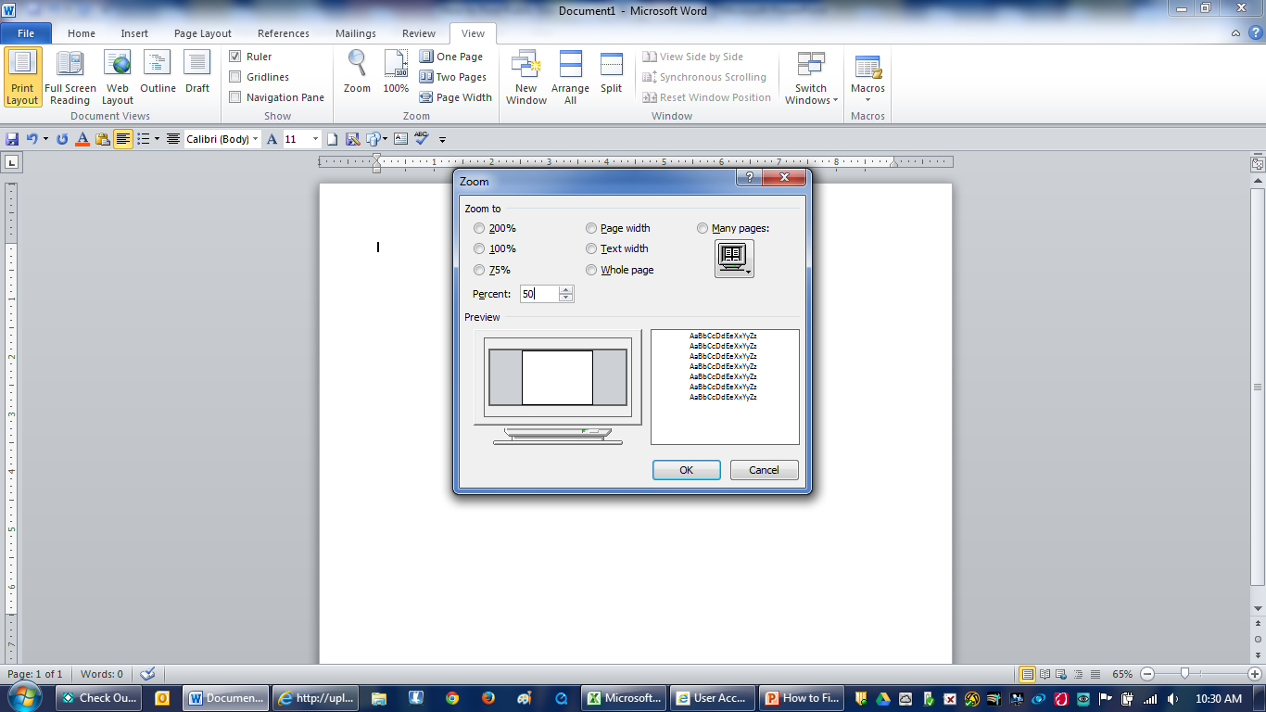
1. Select “View”
2. Click “Zoom”
3. Click
75%
4. Click “Ruler”

Slide 16
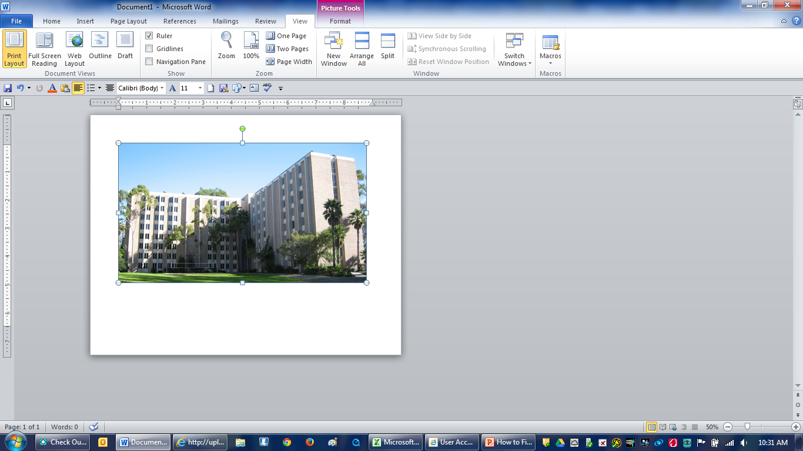
Reset margins to ½” to fill page.

Slide 17
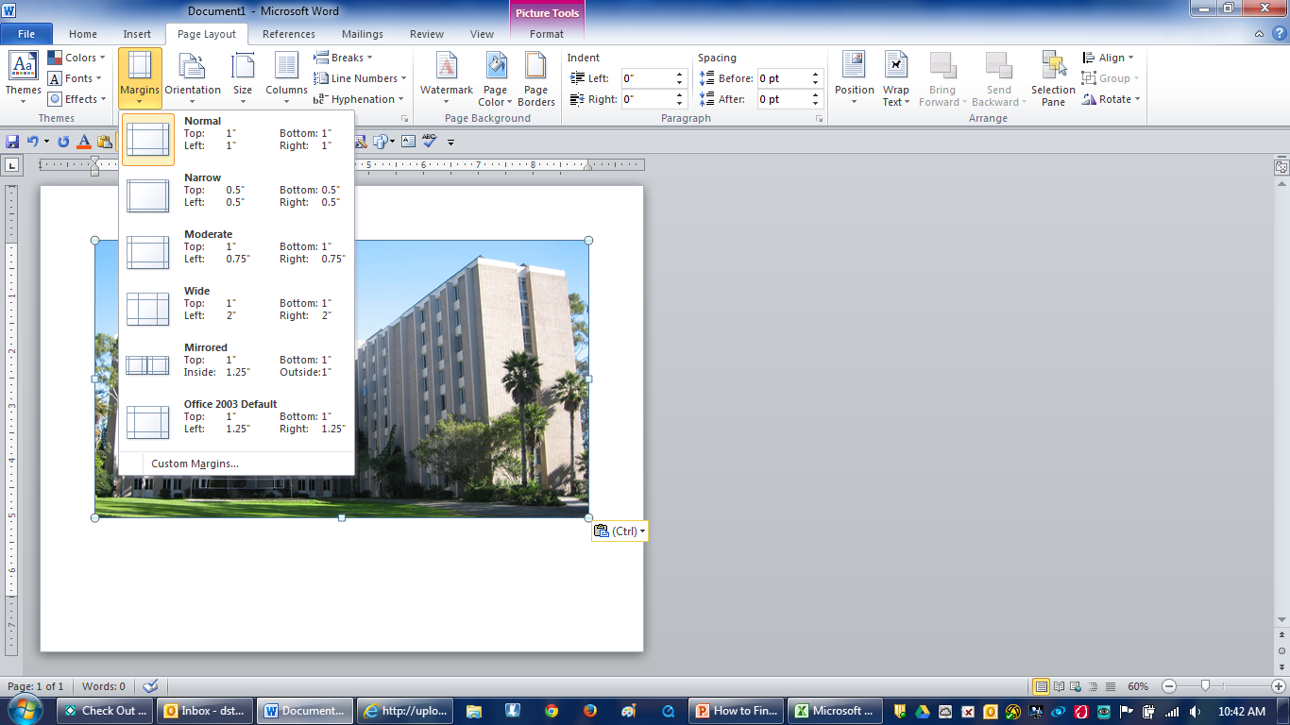
Reset margins to ½” to fill page:
Select “Page Layout”
Click “Margins”
Click “Narrow”

Slide 18
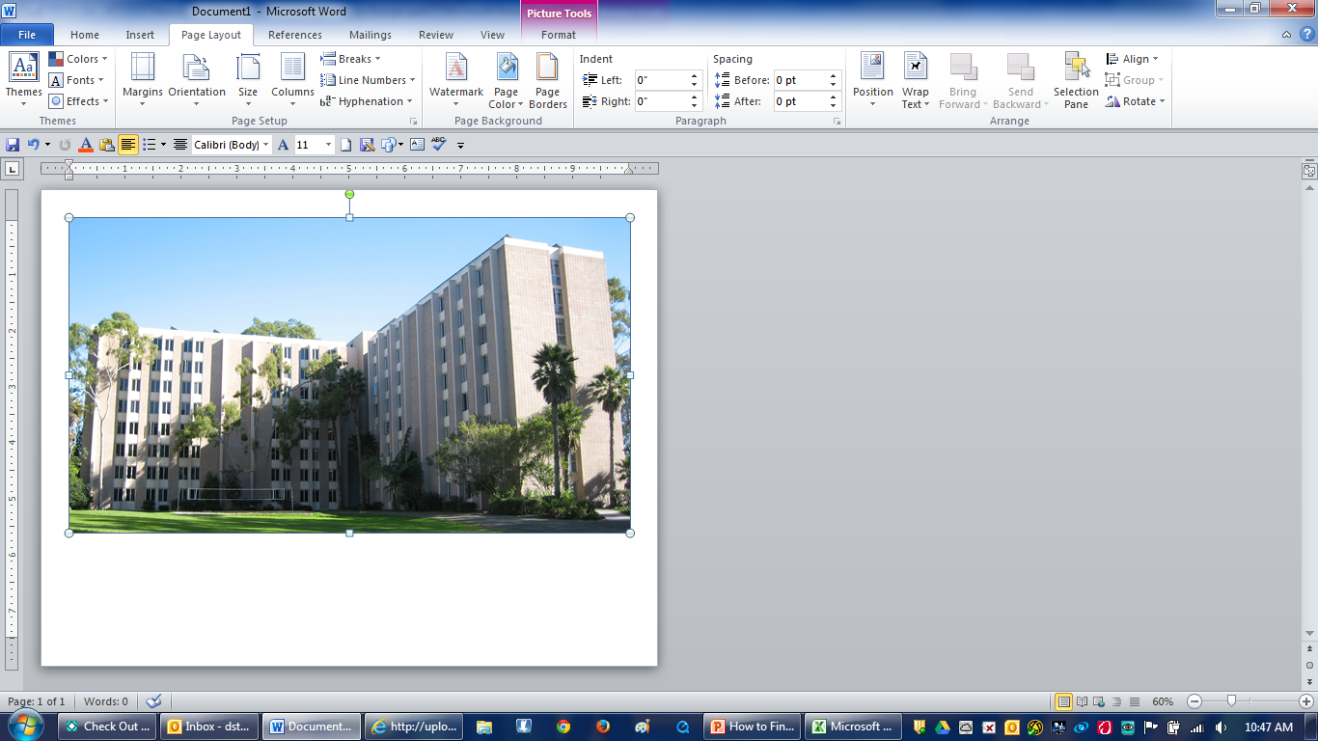
ASK to print!

