Slide 1
Shelving Books
Ms. Ellis, Teacher Librarian

Slide 2
How is a school library organized?
Everything in the library is organized into one of two categories:
Fiction
Nonfiction
Fiction is anything that is made up, make believe, and not real.
Nonfiction is anything that is real, true, and not made up.

Slide 3
Fiction
Fiction has characters, a setting, a plot, and a conflict that is made up by an author.
Some examples of fiction titles:
Harry Potter and the Sorcerer’s Stone
The Hunger Games
Twilight

Slide 4
Nonfiction
Nonfiction is anything that is real
Nonfiction is any library material about a real person, a real place, or a real thing.
Examples of nonfiction:
Anything found in your school textbooks

Slide 5
How is fiction organized?
In a school library, fiction is organized:
Alphabetically by the author’s last name (if a novel)
Alphabetically by the title (if a story collection)
Fiction books will have a spine label that will say “FIC” and then three letters after it that correspond to the first three letters of the author’s last name
For example: If the author’s last name is “Ellis,” then the spine label will say “FIC” and then “ELL”
Fiction books may have a spine label that says “SC” and then three letters.
“SC” indicates it is a story collection and the three letters after will be the first three letters of the title of the work.

Slide 6
Fiction Examples
FIC
EL
SC
FIR

Slide 7
Fiction Examples
FIC
MIL
SC
ZOM
Fiction
Ellis (the last name of the author)
Story Collection
Firebirds Rising (the title of the story collection)

Slide 8
Fiction Examples
FIC
MIL
SC
ZOM
Fiction
Ellis (the last name of the author)
Story Collection
Firebirds Rising (the title of the story collection)
Story collections are organized by the title of the work since a collection of short stories (a story collection) may have more than one author

Slide 9
Please note!!!
When alphabetizing story collections by title, ignore “a”, “an”, and “the” at the beginning of the title.
The Hunger Games would be alphabetized under “H” for “Hunger”, not “T” for “The”
There are so many titles that begin with “a”, “an”, or “the” that the A section and T section would be too big to be used.

Slide 10
Fiction is put in this order:
Author’s last name
Author’s first name
Title of the work

Slide 11
So...
If two books have the same author’s last name, then you look at the author’s first name.
If two books have the same author’s last name AND first name, then you look at the title.
If two books are the same author’s last name, first name, and title, then it’s essentially the same book.

Slide 12
So...
The Hunger Games by Suzanne Collins
Catching Fire by Suzanne Collins
Mockingjay by Suzanne Collins
The Fattening Hut by Pat Collins
would be in this order...

Slide 13
So...
The Hunger Games by Suzanne Collins 3
Catching Fire by Suzanne Collins 2
Mockingjay by Suzanne Collins 4
The Fattening Hut by Pat Collins 1
because...

Slide 14
So...
The Hunger Games by Suzanne Collins Catching Fire by Suzanne Collins
Mockingjay by Suzanne Collins
The Fattening Hut by Pat Collins 1
they both have the same last name, so then you look at the first name. Pat is before Suzanne.

Slide 15
So...
The Hunger Games by Suzanne Collins 3
Catching Fire by Suzanne Collins 2
Mockingjay by Suzanne Collins 4
then for the rest of them, since the author has the same first and last name, then you look at the title of the work (ignoring “a”, “an”, and “the”)

Slide 16
The Hunger Games by Suzanne Collins 3
Catching Fire by Suzanne Collins 2
Mockingjay by Suzanne Collins 4
The Fattening Hut by Pat Collins 1
Get it?

Slide 17
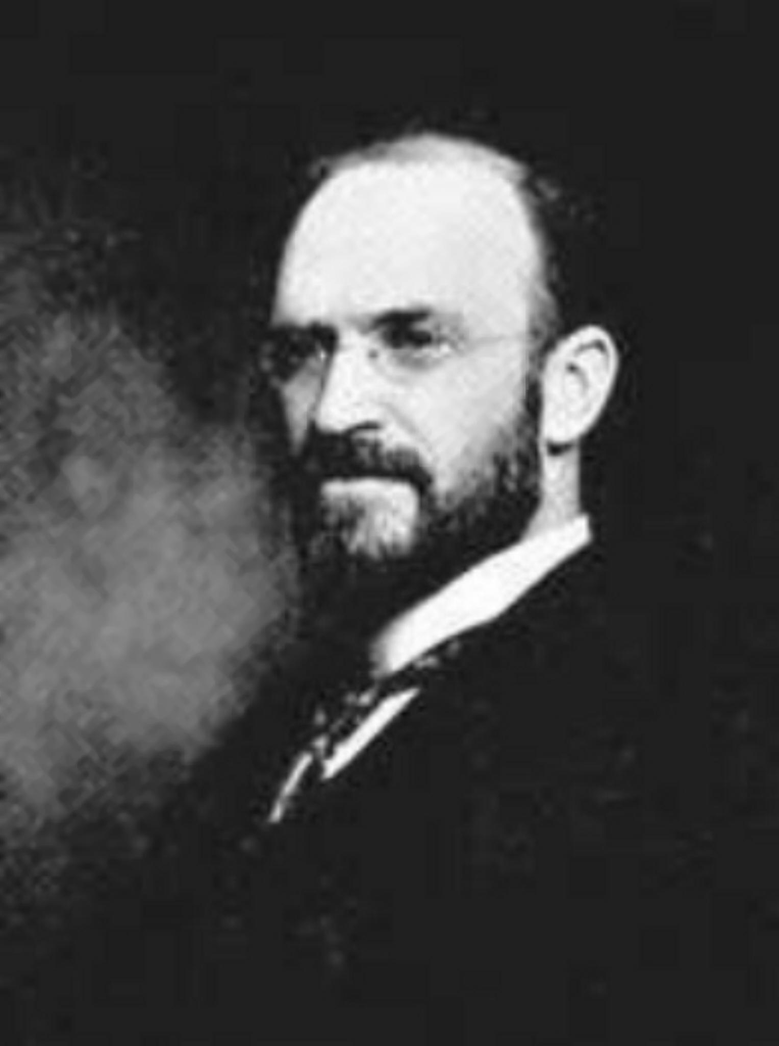
How is nonfiction organized?
Numerically
A man named Melvil Dewey
took all of human knowledge and
organized it into 10 classifications:
000s, 100s, 200s, 300s, 400s, 500s,
600s, 700s, 800s, and 900s.
Each classification was a topic of
human knowledge.

Slide 18
000s - General Knowledge
100s - Philosophy and Psychology
200s - Religion
300s - Social Sciences
400s - Languages
500s - Science
600s - Technology
700s - Arts and Recreation (including Sports)
800s - Literature
900s - History and Geography

Slide 19
How the Dewey Decimal System Works
The more numbers you add in the more specific the topic of human knowledge gets
For example:
900.00* is History & Geography
970.00* is History of North America
973.00* is History of the United States
973.90* is U.S. History after 1900
973.93 is U.S. History from 2001 - Present
*You don’t normally end a Dewey Decimal number with a zero after the decimal point. 973.90 is the same as 973.9

Slide 20
Putting the Numbers in Order
Generally speaking, when putting numbers with decimal points in order, you ignore all the numbers that are the same from left to right:
Example: 973.95 and 973.93

Slide 21
Putting the Numbers in Order
Generally speaking, when putting numbers with decimal points in order, you ignore all the numbers that are the same from left to right:
Example: 973.95 and 973.93
You just look at the 5 and the 3.
Since 3 is lower than 5. 973.93 is before 973.95 on the shelf.

Slide 22
Let’s try another one...
286.05
286.51

Slide 23
Let’s try another one...
286.05
286.51
Ignoring the first 3 numbers that are the same, you have 5 and 51 left. Since 5 is lower than 51, 286.05 is before 286.51 on the shelf.

Slide 24
One last one...
478.01
478.1

Slide 25
One last one...
478.01
478.10 (adding a zero at the end doesn’t change the number)

Slide 26
One last one...
478.01
478.10
After ignoring the first three numbers that are the same, you have 1 and 10 left. Since 1 is lower than 10, 478.01 is before 478.10 on the shelf.

Slide 27
Note!!
If all of the numbers are the same, then look at the letters after the number:
921 ROD
921 KIN
921 KIN is before 921 ROD on the shelf since K comes before R in the alphabet
The letters after the number is generally the first three letters of the author’s last name (just like in fiction). Exception: 921s are biographies. The letters after the number are for the last name of the person the biography is about.

Slide 28
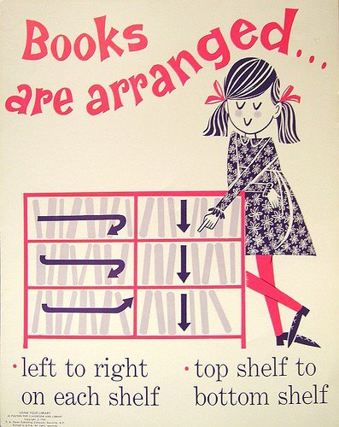
Once you know the order of the books, putting on the shelf is easy.

Slide 29
Think you got it?
Take the quiz

